Slide 1
Lecture 10
Topics: Inheritance
Chapter 11, Sections 11.1 - 11.6

Slide 2

Motivation
Plan your programs with the future in mind.
If there were a way to write Java code so that you could take more vacations, how much would it be worth to you?
What if you could write code that someone else could extend/modify, easily?
And if you could write code that was flexible, for those pesky last-minute spec changes, would that be something you're interested in?

Slide 3
Inheritance
Suppose you want to create/define classes in order to model circles, rectangles, and triangles.
These classes have many common features.
What is the best way to design these classes so to avoid redundancy?
The answer is to use inheritance.

Slide 4
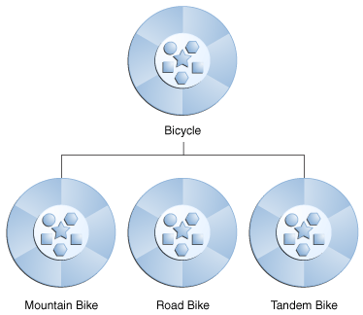
Example
A bicycle is a general term for any kind of bicycle.
Mountain bikes, road bikes and tandem bikes are all types of a bicycle.
They have certain things in common with each other. And certain things that are different.

Slide 5
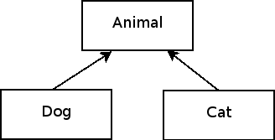
Example
A dog and cat are types of animals.
They have certain properties in common and behaviors in common.
And other behaviors and properties that are different.

Slide 6
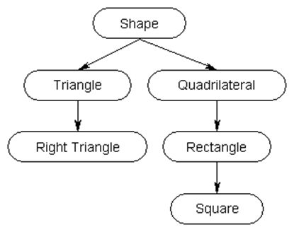
And another example...
Triangles and rectangles are both shapes.
You can find the area for both of them, but you have to do it different ways.

Slide 7
Superclass
The most general class. The superclass is the class that is created first. Also called the base class or the parent class.
superclass

Slide 8
superclass
superclass

Slide 9
Subclass
A specialized class. The subclass is derived (or based on) the superclass. Also called the derived class, the child class, and the extended class.
subclasses

Slide 10
subclasses
subclasses

Slide 11
Extends
When one class inherits from another, we say that the subclass extends the superclass.
1. Mountain Bike extends Bicycle
2. Road Bike extends Bicycle
3. Tandem Bike extends Bicycle

Slide 12
The IS-A Test
If you want to know if one class should extend another class, you use the IS-A test.
1. Mountain Bike IS-A Bicycle - yup!
2. Road Bike IS-A Bicycle - yup!
3. Tandem Bike IS-A Bicycle - yup!

Slide 13
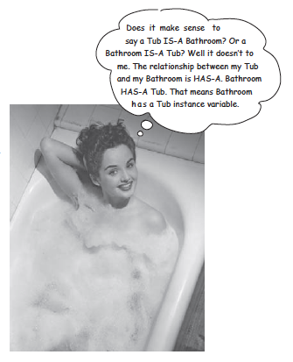
Bathroom and Tub Example
Does it make sense to say that a Bathroom IS-A Tub?
Does it make sense to say that a Tub IS-A Bathroom?
No! A Bathroom HAS-A Tub!
This is the difference between aggregation/composition and inheritance!

Slide 14
The HAS-A Test
If two things are related, but the IS-A case does not apply and you think that the two things are related, you can use the HAS-A test.
If one thing HAS another thing, then the second thing is an instance variable!
Remember, this is composition and aggregation (Chapter 10).

Slide 15


IS-A vs HAS-A
IS-A
HAS-A
Actor
?
(Instance variable)
Movie
Daniel Craig

Slide 16
Let's talk code...
public class Doctor
{
private boolean worksAtHospital;
public void treatsPatient()
{
System.out.println("Are you feeling ok?");
}
}
public class Surgeon extends Doctor
{
public void operates()
{
System.out.println("Time to go under!");
}
}
You must have the extends
keyword.
Remember: Surgeon
IS-A Doctor. Therefore, Surgeon
extends Doctor.

Slide 17

Ok...How do you use those classes?
public class DoctorsInAction
{
public static void main(String[] args)
{
Doctor doc1 = new Doctor();
System.out.println("Doc1: ");
doc1.treatsPatient();
Surgeon doc2 = new Surgeon();
System.out.println("Doc2: ");
doc2.operates();
doc2.treatsPatient();
}
}
A subclass "inherits" or gets all of the public
methods and instance variables of the superclass - without you having to rewrite them!!

Slide 18
public class Doctor
{
private boolean worksAtHospital;
public void treatsPatient()
{
System.out.println("Are you feeling ok?");
}
}
main
Heap
doc1
worksAtHospital: false
treatsPatient()
public class Surgeon extends Doctor
{
public void operates()
{
System.out.println("Time to go under!");
}
}
doc2
treatsPatient()
operates()
Output
public class DoctorsInAction
{
public static void main(String[] args)
{
Doctor doc1 = new Doctor();
System.out.println("Doc1: ");
doc1.treatsPatient();
Surgeon doc2 = new Surgeon();
System.out.println("Doc2: ");
doc2.treatsPatient();
doc2.operates();
}
}
Doc1:
Are you feeling ok?
Doc2:
Are you feeling ok?
Time to go under!

Slide 19
Do it again!
public class Doctor
{
private boolean worksAtHospital;
public void treatsPatient()
{
System.out.println("Are you feeling ok?");
}
}
Two subclasses!!
public class Surgeon extends Doctor
{
public void operates()
{
S.O.P.L("Time to go under!");
}
}
public class Pediatrician extends Doctor
{
public void helpsKids()
{
S.O.P.L("I help kids!");
}
}

Slide 20
Ok...and how do I use the classes?
public class MoreDoctorsInAction
{
public static void main(String[] args)
{
Doctor doc1 = new Doctor();
System.out.println("Doc1: ");
doc1.treatsPatient();
Surgeon doc2 = new Surgeon();
System.out.println("Doc2: ");
doc2.treatsPatient();
doc2.operates();
Pediatrician doc3 = new Pediatrician();
System.out.println("Doc3: ");
doc3.treatsPatient();
doc3.helpsKids();
}
}

Slide 21

What don't you get with inheritance?
Private instance variables or methods. But you can use any available public getters and setters to access them.
Multiple inheritance - using extends for multiple classes (A extends B and C). Java does not allow this. Some languages do.
Constructors. Sadness…

Slide 22

Constructors and the super keyword
Constructors are not inherited.
They are invoked (i.e. called).
They can only be invoked from the subclasses' constructors, using the keyword super.

Slide 23
The super keyword
The keyword super refers to the superclass of the class in which super appears.
It can be used in two ways: - To call a superclass constructor - To call a superclass method
The statement super() calls the default, no-argument constructor of its superclass.
The statement super(arguments) calls the superclass constructor that matches the arguments.
If the keyword super is not explicitly used, the superclass's no-arg constructor is automatically invoked (Remember: If you cannot afford a lawyer, one will be provided for you...).

Slide 24
A superclass's constructor is always called
A constructor may call an overloaded constructor or its superclass’s constructor.
If no constructor is explicitly called, the compiler puts super() as the first statement in the constructor.
public A()
{
}
public A()
{
super();
}
public A(double d)
{
}
public A(double d)
{
super();
}

Slide 25
Example
public class Fruit
{
public Fruit()
{
System.out.println("Fruit default");
}
}
public class Apple extends Fruit
{
public Apple()
{
super();
System.out.println("Apple default");
}
}
super() must be the first thing that happens in the child class constructor
Otherwise, Java adds it for you as the first line!

Slide 26
public class Fruit
{
public Fruit()
{
System.out.println("Fruit default");
}
}
main
Heap
(Fruit)
f
public class Apple extends Fruit
{
public Apple()
{
super();
System.out.println("Apple default");
}
}
(Apple)
a
Output
public class FruitTest
{
public static void main(String[] args)
{
Fruit f = new Fruit();
Apple a = new Apple();
}
}
Fruit default
Fruit default
Apple default

Slide 27
Example
public class Fruit
{
public Fruit()
{
System.out.println("Fruit default");
}
public Fruit(int numFruit)
{
System.out.println("Fruit: " + numFruit);
}
}
public class Apple extends Fruit
{
public Apple()
{
super(4);
}
}
Matchy-matchy!!

Slide 28
What happens now?
public class Fruit
{
}
public class Apple extends Fruit
{
}
Remember, when you don't define a constructor, Java provides one for you - a default, no-arg constructor.
When you don't call super() explicitly, Java calls it for you as the first line of the child class constructor.

Slide 29

What happens here?
public class Fruit
{
public Fruit(int numFruit)
{
System.out.println("Fruit: " + numFruit);
}
}
public class Apple extends Fruit
{
public Apple()
{
}
}
Since super() is not explicitly called in the subclass, Java adds super() for you and calls the default, no- arg constructor.
The superclass does not have a default, no-arg constructor.
Java will not provide one because another constructor was already created.

Slide 30
Another Example
public class Fruit
{
private int n;
public Fruit(int numFruit)
{
this.n = numFruit;
}
}
Calling the constructor sets the instance variable in the superclass.
If you have a public getter, your subclass can get the value of the instance variable!!
public class Apple extends Fruit
{
private String color;
public Apple(String c, int num)
{
super(num);
this.color = c;
}
}

Slide 31

Caution
You must use the keyword super() to call the superclass constructor.
Calling a superclass constructor’s name in a subclass causes a syntax error.
Java requires that the statement that uses the keyword super() appear first in the constructor.

Slide 32
Constructor chaining
public class Person
{
public Person()
{
System.out.println("Person");
}
}
public class Faculty extends Employee
{
public Faculty()
{
System.out.println("Faculty");
}
}
public class Employee extends Person
{
public Employee()
{
this("Call other Employee constructor");
System.out.println("Employee");
}
public Employee(String s)
{
System.out.println(s);
}
}
public class TestFaculty
{
public static void main(String[] args)
{
Faculty f = new Faculty();
}
}
Person
Call other employee constructor
Employee
Faculty
this(parameters) calls the constructor in that class with the specified arguments.

Slide 33
Calling superclass methods
The keyword super can also be used to reference a method in the subclass other than the constructor in the superclass.
Syntax: super.method(parameters);
super(); or super(parameters); // constructor
super.method(); or super.method(parameters); // methods

Slide 34


How do I remember which one is which???
Super-dot: Calls superclass method
Super-parentheses: Calls superclass constructor
constructors
methods

Slide 35
public class Animal
{
public Animal(int n)
{
System.out.println("Animal: " + n);
}
public void sleep()
{
System.out.println("ZZZZZZZZ");
}
public void makeNoise()
{
System.out.println("Groowwwwwl");
}
}
public class Test
{
public static void main(String[] args)
{
Cat c = new Cat();
c.printInfo();
c.sleep();
c.makeNoise();
}
}
Output
Animal: 4
ZZZZZZZZ
Groowwwwwl
ZZZZZZZZ
Groowwwwwl
public class Cat extends Animal
{
public Cat()
{
super(4);
}
public void printInfo()
{
super.sleep();
super.makeNoise();
}
}

Slide 36

Why is my cat growling? This does not make sense...

Slide 37
Overriding Methods
Sometimes it is necessary for a subclass to modify the implementation of a method defined in the superclass.
Overriding a method is the process of redefining the method in a subclass.
To avoid mistakes, you can use a special Java syntax, called override annotation. Place @Override before the method in the subclass.
This annotation specifies that the following method is required to override a method in the superclass.
If a method with this annotation does not override its superclass’s method, the compiler will report an error.

Slide 38
public class Animal
{
public Animal(int n)
{
System.out.println("Animal: " + n);
}
public void sleep()
{
System.out.println("ZZZZZZZZ");
}
public void makeNoise()
{
System.out.println("Groowwwwwl");
}
}
public class Cat extends Animal
{
public Cat()
{
super(4);
}
public void printInfo()
{
super.sleep();
makeNoise();
}
@Override
public void makeNoise()
{
System.out.println("Meow");
}
}
@Override annotation
Must have the same method header as the superclass method.

Slide 39
Do not confuse overriding with overloading
Overriding | Overloading
Overridden methods are in different classes related by inheritance. Overridden methods have the same parameter list, name and return type | - Overloaded methods can be either in the same class or different classes related by inheritance - Overloaded methods have the same name but a different parameter list.

Slide 40
The Object class
Every class in Java, including the ones that you create, are descended from the Object class.
All classes (including user-defined classes) implicitly extend the Object class (you just don't see the extends keyword).
The Object class has 11 methods.
The equals() method and the toString() methods are commonly overridden in many subclasses to create functionality specific to that class.

Slide 41
How is toString() defined in the Object class?
public String toString()
{
return getClass().getName() + '@' + Integer.toHexString(hashCode());
}

Slide 42
Overriding the toString() method
public class Frog
{
@Override
public String toString()
{
return "This is a frog";
}
}
You do not have to explicitly extend Object.
Java does this for you implicitly.
Same method header as the method from Object and the @Override annotation.

Slide 43

That’s all for today!
Homework #6 is due Thursday, 03/03/16 at 9:00 a.m.
Read your book!!

